Slide 1

Investment Portfolio Value at Risk (VAR)
David Simbandumwe | DATA 618 Fall 2023 w5

Slide 2
Random Number Generator - Scenario 4
You are a 55-year-old painting contractor. You and your spouse own you home on which there is a mortgage balance of $262,000. Your savings account balance is $6,000 and you have no other investments. You have three children ages 16, 13 and 9. GREAT NEWS; you have just one the state lottery and have opted for a one time cash payout that will amount to $ 125 M.
Notes:
Assume NY State Resident (24% Federal Tax / 8.82% NY State Tax) total $41,025,000
Net proceeds from the winnings $83,975,000
Including current balance sheet Total Assets $83,719,000
https://blog.taxact.com/lottery-tax-calculator/#calculator

Slide 3
Financial Profile
Financial Goals?
capital preservation - protecting the value generated from the business that he built over the years
tax planning - minimize tax exposure
retirement planning & estate planning - plan for early retirement and the eventual transfer of wealth
education - planning to fund post secondary education for 3 children
Investment Timeline?
multiple generations - the portfolio balance is generational wealth and should be managed accordingly
Risk Appetite?
average risk tolerance - planning across multiple generations we want to preserve capital but take advantage of growth opportunities. We will take a balanced approach to this portfolio

Slide 4
Recommendations
Wealth and Estate Planning
tax planning - engage a tax lawyer prior to accepting the winnings and maintain a working relationship
wealth planning - engage a financial planning team to assist with cash management, and investment management
retirement planning & estate planning - begin long term planning for retirement and wealth transfer
Debt Management
payoff current mortgage - although the marginal returns from $262,000 would likely outweigh the interest payments on that asset that value is small compared to the overall balance sheet. Look for other opportunities to borrow against real-estate at a more favorable rate

Slide 5
Portfolio Construction
Asset Class | Sub Class | Allocation | Value
Economically Sensitive Exposures | U.S. Equities | 25.0% | 21,000,000
 | International Equities | 10.0% | 8,000,000
 | Emerging Market Equities | 5.0% | 4,000,000
 | Publicly Traded REITs | 3.0% | 2,500,000
 | Private Real Estate | 10.0% | 8,300,000
 | Private Equity | 5.0% | 4,200,000
 | Long/Short Equities | 2.0% | 2,250,000
 |  | 60.0% | $ 50,250,000
Interest Rate Sensitive Exposures | U.S. Government Bonds | 20.0% | 17,000,000
 | Very-High-Quality Corporate Bonds | 7.5% | 6,000,000
 | Very-High-Quality Municipal Bonds | 7.5% | 6,000,000
 |  | 35.0% | $ 29,000,000
Cash on hand | Cash | 5.0% | 4,469,000
allocation - Whitwell and Villalta did not propose a target allocation for new taxonomy
60/40 portfolio proposed here includes PE and other “alternative investments”
added cash - even though the portfolio includes liquid assets
overtime we will aim to diversify equity holdings

Slide 6
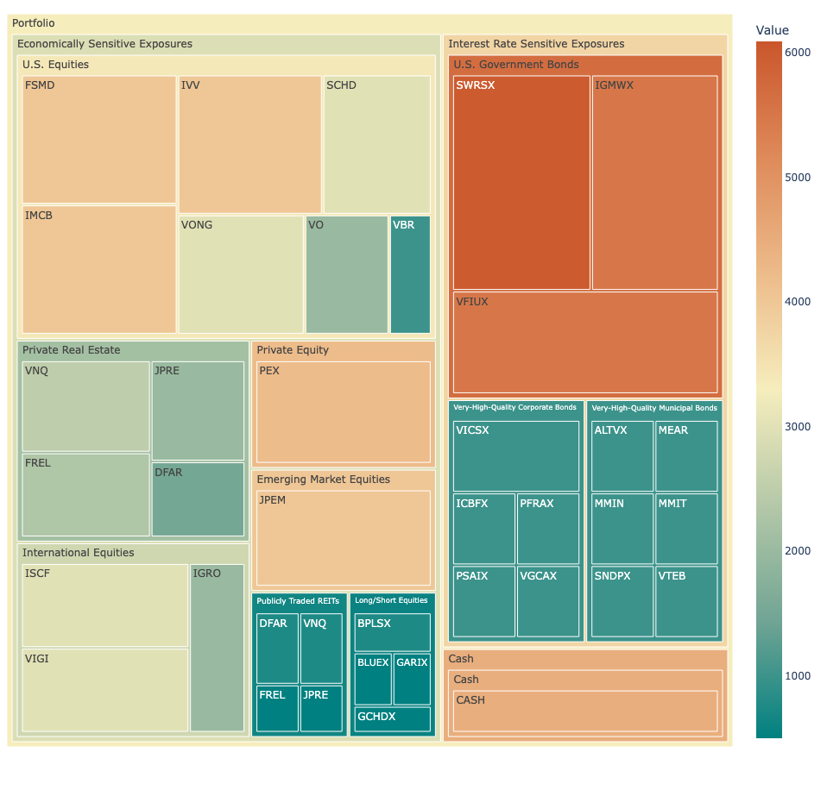
Portfolio Allocation
mutual fund / ETF - Built a portfolio using Mutual Funds and ETF
other options - given the portfolio size other investment options could make sense, Separately Managed Account, Private Equity, Treasury Direct etc
added cash - even though the portfolio includes liquid assets

Slide 7

Value at Risk (VaR)

Slide 8
Approach
Load Data
load portfolio - load the 60/40 portfolio for scenario 4
load daily close time series - load the daily adjusted closing prices for all holdings in the portfolio from 2020
Percent Calculations
daily percentage change - calculate the daily percentage change for the time series
portfolio weights - generate a list of portfolio weights
Var Calculations
VaR - calculate historic, parametric and monte carlo VaRs using alpha value of 0.05
Backtest - graph VaR backtests for portfolio

Slide 9
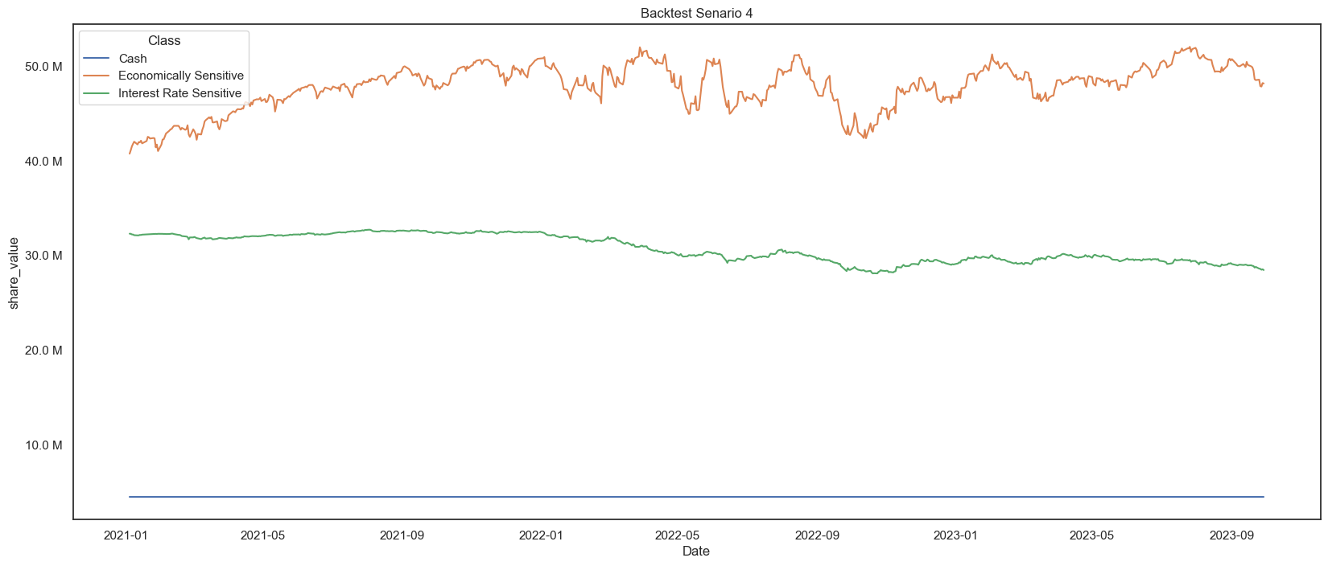
Backtest Portfolio (start date 2021)
economic exposure - clearly see the growth benefits of assets with economic exposure
interest exposure - limited appreciation in interest exposure classes

Slide 10
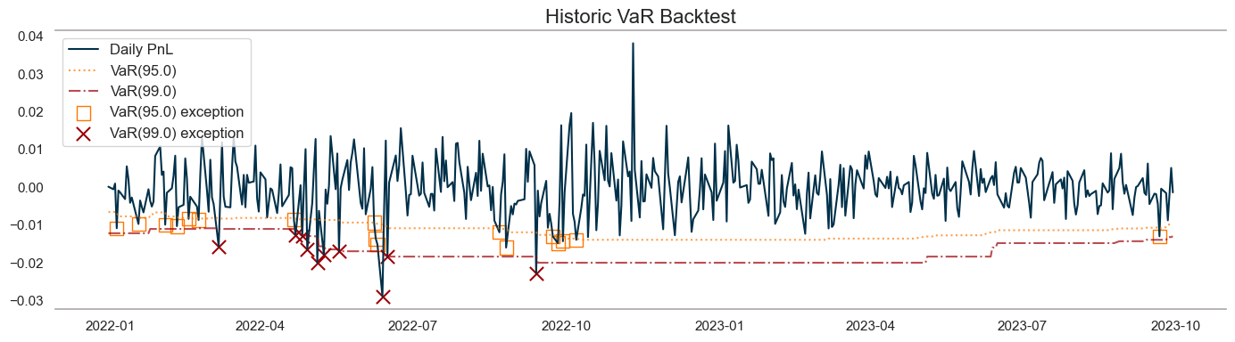
Historic VaR Backtest (start date 2021)
95.0% - 15 exceptions is over expected 12.5 exceptions
99.0% - 10 exceptions is above expected 2.5 exceptions
note:

Slide 11
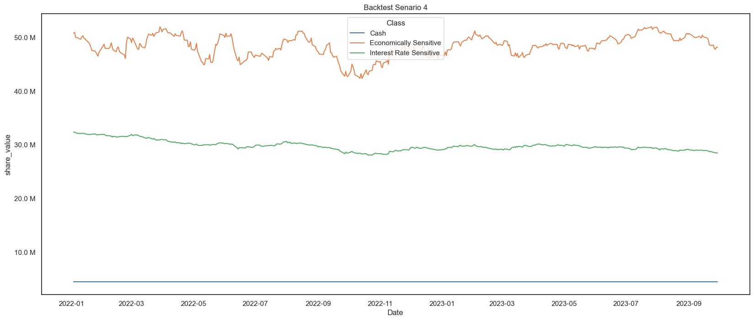
Backtest Portfolio (start date 2022)
economic exposure - flat since the beginning of 2022
interest exposure - slight decline since beginning of 2022

Slide 12
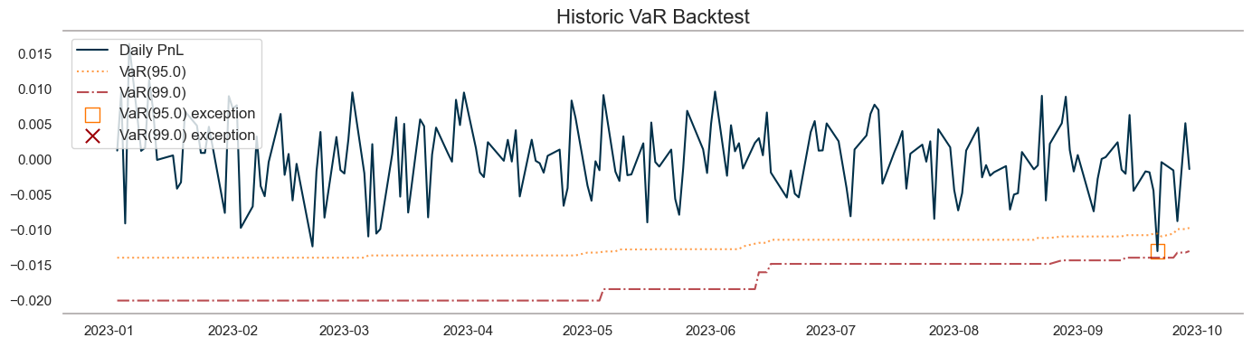
Historic VaR Backtest (start date 2022)
95.0% - 1 exceptions is below expected 12.5 exceptions
99.0% - 0 exceptions is below expected 2.5 exceptions
note:

Slide 13
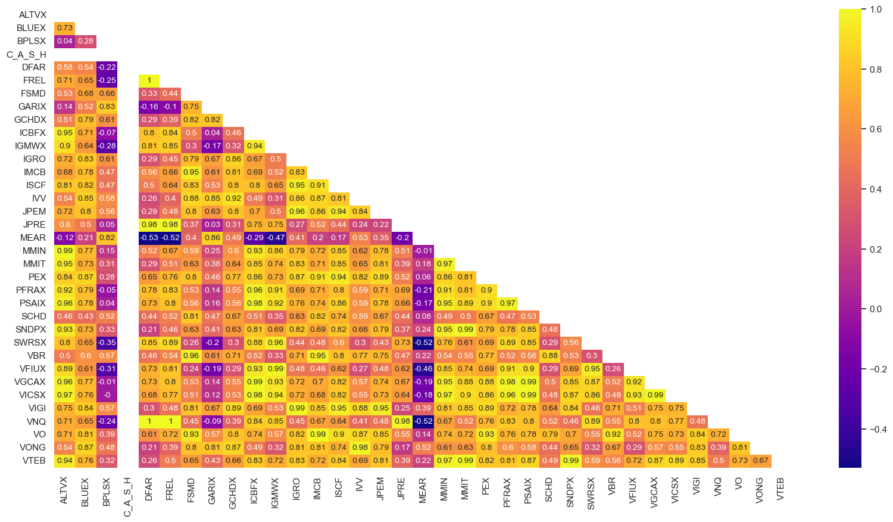
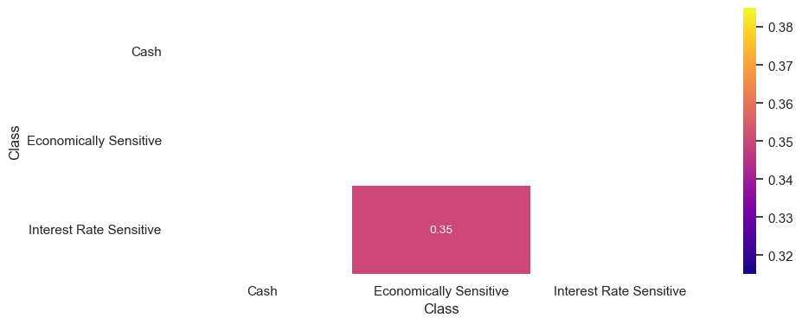
Asset Correlation Since 2022
class grouping - grouping assets by class may provide more insight into the portfolio behavior
negative correlation - negative correlation between economic and interest sensitive assets

Slide 14
VaR
 | Measure | Percent | Value
Portfolio Summary | 𝝁 |  | 0.03%
 | 𝞼 |  | 0.72%
 | Portfolio 𝞼 |  | 0.72%
Daily VaR (𝛂 = 0.05) | Historic | -1.23% | ($ 1031005)
 | Parametric | -2.38% | ($ 1,993,653)
 | Monte Carlo | -1.20% | ($ 1,008,330)
mean portfolio returns -0.03%
unweighted portfolio volatility 0.72%
weighted portfolio volatility 0.72%
Parametric VaR - significantly higher than historic or monte carlo

